Slide 1
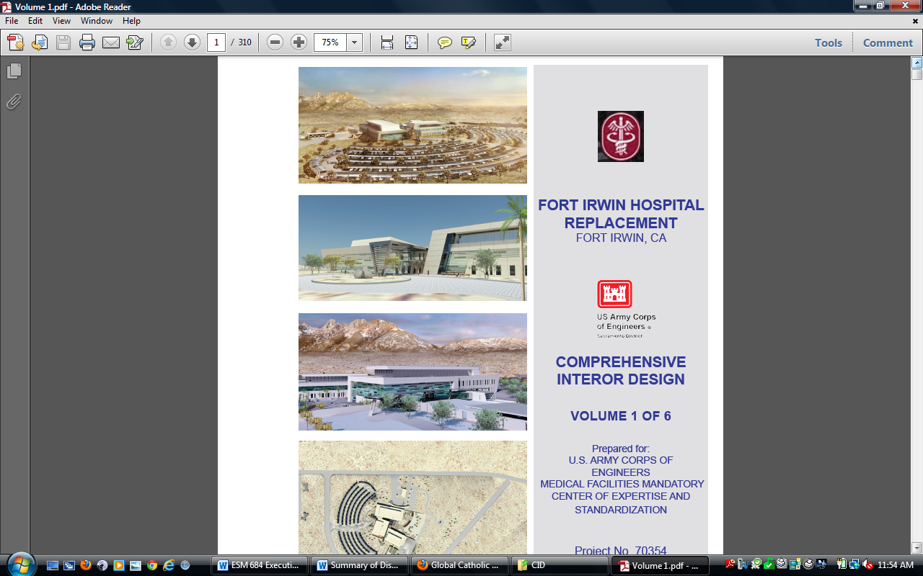
Military Health Facility Capital Investment Planning
Tuesday April 17, 2012 at 3:00 PM
in
535 Duckering BLD
University of Alaska Fairbanks
You are invited to attend the
Engineering Science Management
Masters Program Final Project
for
Scott Shopa
A look at the Military Medical System’s
capital investment decision process and recommendations for reducing costs.

Slide 2
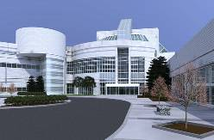
Military Health Facility Capital Investment Planning
Advisor: Dr. Robert Perkins
Committee: Dr. J. Leroy Hulsey, Dr. Robert Perkins, & Keith Whitaker
ESM 684: Masters of Science Degree Project – Spring 2012
Department of Civil and Environmental Engineering
College of Engineering and Mines
University of Alaska - Fairbanks

Slide 3
Why Health Facility Planning?
Seven Classes directly applied to this material
This is my profession
Attempt to employ my studies directly to my next assignment

Slide 4
Applied Education
Masters Project Assignment
Design Project Scheduling
Alternative Project Delivery Systems
Project Proposals
Project Management
Functions for Calculus
Managing & Leading Engineering Organizations
Engineering Decisions
Project Management
Engineering Decisions
Pre-Construction Contracts
Human Resource Management
Construction Claims
Construction Related Law Topics
Leadership/Management (family of Classes)
Accounting for Managers

Slide 5
Outline
Problem Statement
Introduction
MHS Capital Investment
Goal
Planning Process
Funding Process
Bid Selection Preparation
Recommendations

Slide 6
Problem Statement
The idea behind this project is to explain the process of building a new Army Hospital from the conception of a medical requirement to bid selection.
What recommendations can be made to improve the selection process?

Slide 7
Introduction
MHS Capital Investment
Importance of MHS Capital Investment
Unique Capital Investment Decision Making

Slide 8
MHS Capital Investment
Budget outlay by the DoD for the purpose of building new medical facilities or renovating existing outdated facilities
$250 to $300 million dollar a year budget.
POM – 2010 work creates the 2012-2017
BES – 2012 and 2013 the stable submissions
Execution – Large MILCON requires 2 years

Slide 9
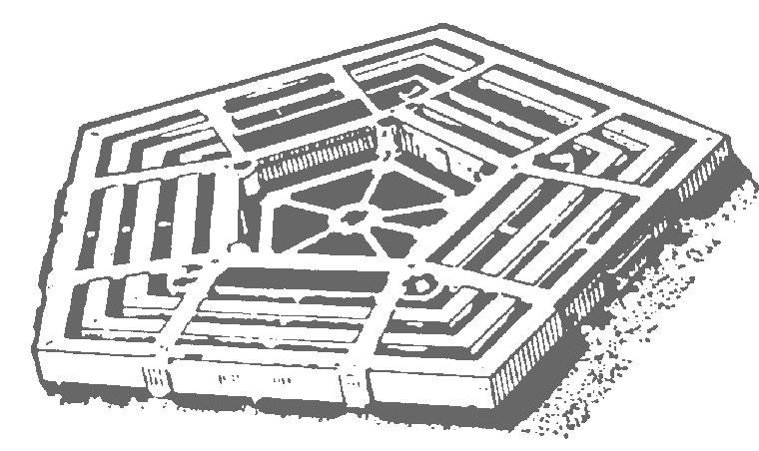
MHS Capital Investment
Execution Performance
Congressional Mark-up
Current Budget
INPUT
INPUT
P O M
Decision Support
Process
INPUT
OSD
INPUT
OUTPUT
BES
Budget Guidance
INPUT
Refine Requirements
and Missions
(Transfers In / Out)
Budget Estimate Submission (BES)
Notes:
· The Army POM is the Baseline for the Army Budget (i.e., BES).
· The decision process for developing the BES is the same as for developing the POM.
· The task is to turn Army MDEPs into a part of the OSD BES, organized by Congressional Appropriation.
· You should remember from the Programming class that the Economic Adjustments are done by the UA PEG, and are the “z” MDEPs. OMB will probably revise them at this point.

Slide 10
Importance of MHS Capital Investment
Kaiserslautern Military Hospital, located in Germany was built in 1938 by the Nazi government and is still in use as a United States Army Clinic.
Irwin Army Community Hospital, Fort Riley, Kansas was designed in the 1930s; construction began in 1947 and has been in operation since 1952.
Tripler Army Medical Center located in Hawaii, was completed in 1949 and is designated as a historic building, which the military is still using.

Slide 11
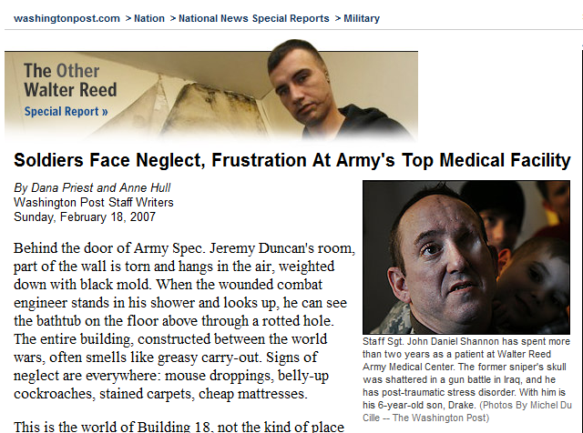
Walter Reed Scandal

Slide 12
Unique Considerations
Unique and complex
Agenda and cost
Multi-functional
News worthy
Special Management

Slide 13
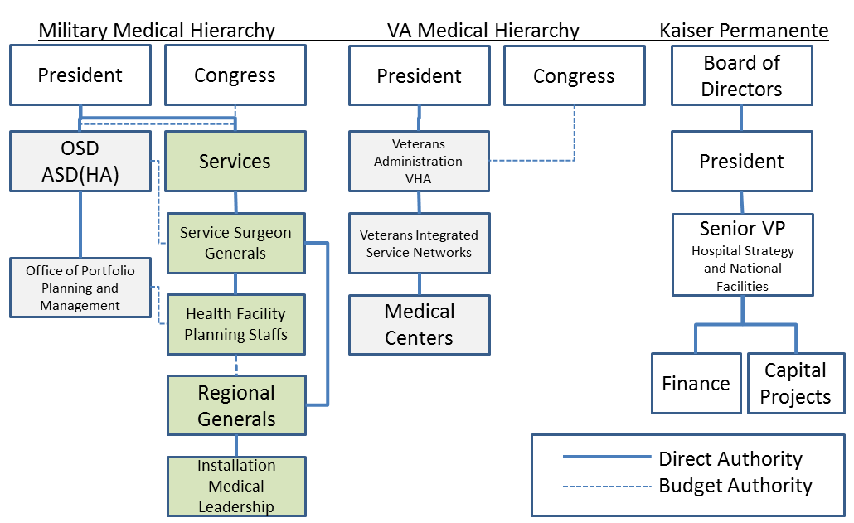
Unique Capital Investment Decision Making
Managing & Leading Engineering Organizations

Slide 14
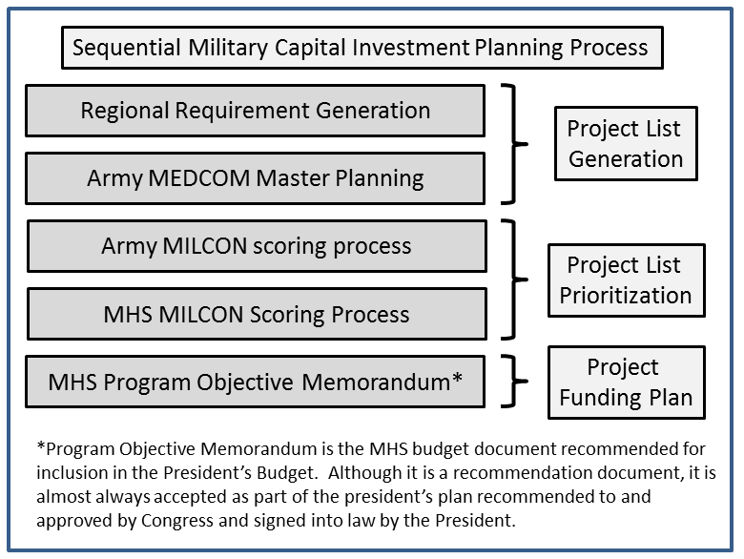
Sequential Military Capital Investment Process

Slide 15
Planning
Historic Process
The 2008 Stimulus fully funded two Army hospitals:
  Fort Benning, Georgia ($507M)
  Fort Riley, Kansas ($404M)
The 2009 ARRA legislation fully funded the $931M dollar Fort Hood hospital in Texas.
Regional Requirements Generation

Slide 16
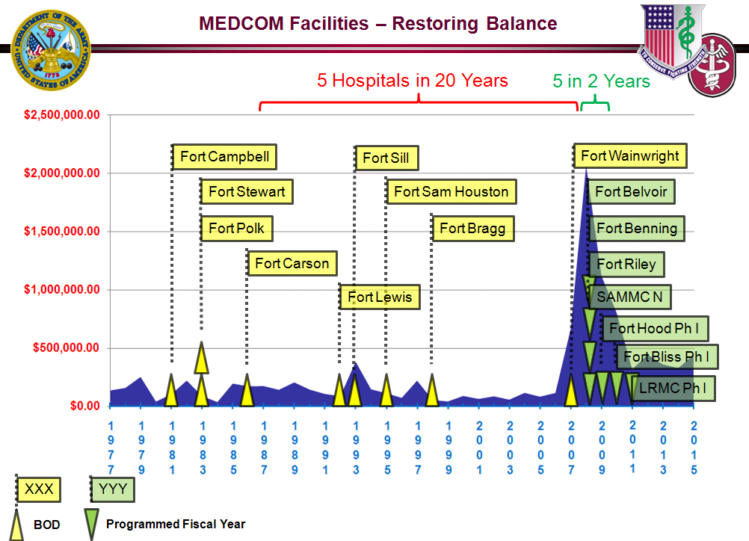
Historical
MILCON
Funding
Functions for Calculus
Engineering Economic Analysis

Slide 17
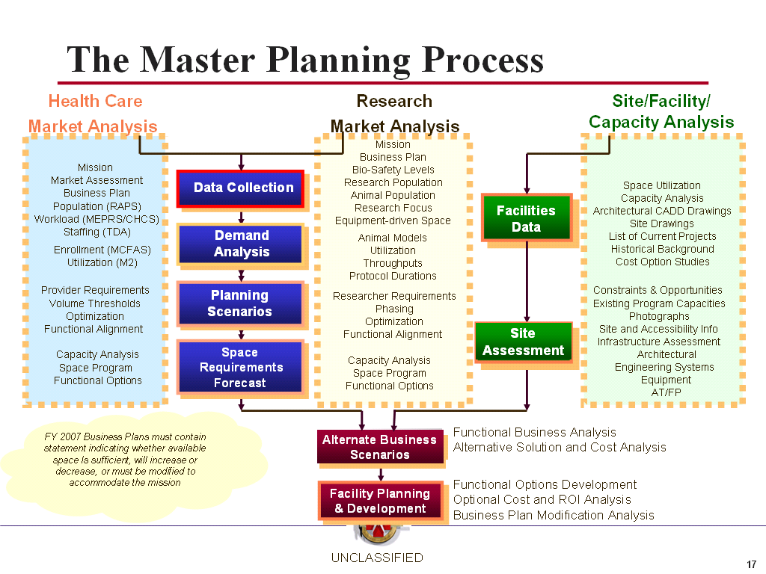
Current Planning
Goal is to merge quantifiable data with leadership objectives.
Population Analysis defines the population using
MHS services and determines to the extent to which
primary verses specialty care is relied upon.
Workload Analysis contrasts historical utilization records with normal workload attributed to the population.
Provider Analysis determines the number and composition of medical providers and recommends the optimal building configurations.
Space Analysis combines workload and staffing forecasts with identified required spaces. This analysis utilizes defining characteristics to determine the sizing of rooms based upon the medical purpose.

Slide 18
Current Planning

Slide 19
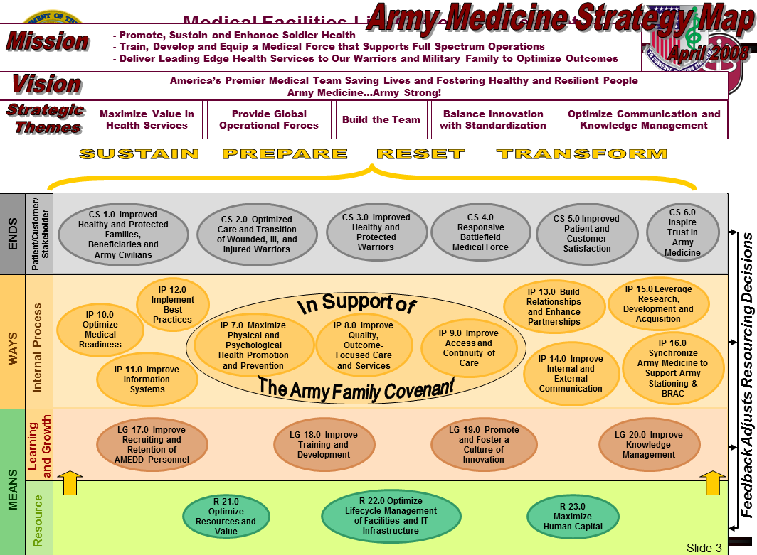
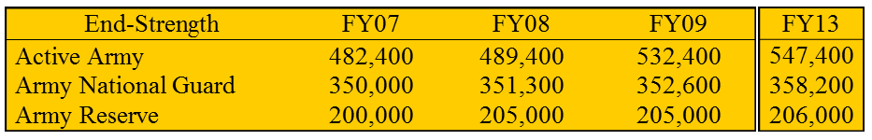
Leadership Objectives
Sustain the force through
recruiting and retention
Prepare troops for success
in the current conflict
Reset the force to prepare for deployments and contingencies
Transform the Army
Organizational Behavior
in Project Management

Slide 20
Transformation
Grow the Force mandated the Army grow from a standing personnel strength of 487K to nearly 550K with a temporarily increased end strength of 580K, which is supposed to have ended by 2012.
Brigade Combat Team re-stationing efforts culminated with highest populations at Fort Bliss, Texas; White Sands Missile Range, New Mexico; Fort Carson, Colorado and Fort Stewart, Georgia. This was a shift of nearly 20K soldiers and nearly 60K family members.
Combat Service/Combat Service Support unit population changes created re-stationing efforts which shifted approximately 20K soldiers to new military installations.
Army Modular Force (AMF) was the redesign of the Army force structure for the purpose of creating smaller stand-alone brigade size formations that could accomplish tasks similar to that of the large Army division formations. The end state of this transformation would build a total of 76 Combat Brigades (48 AC/28 RC) and over 200 Support Brigades and shift soldier basing around the world.
Global Defense Posture Realignment (GDPR) was designed to decrease the Army’s world-wide presence overseas. The end-state was to shift soldiers from forward deployed locations in South Korea and Germany back to installations within the continental United States.

Slide 21
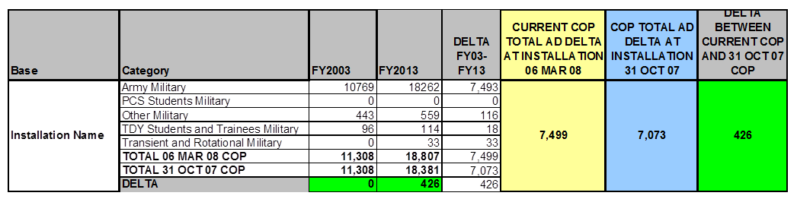
Why Numbers matter…
Changes in soldier populations required adjustments to many of the Army’s medical facilities. COP changes supported the generation of requirements associated with medical facilities.
Engineering Decisions

Slide 22
Population-Based Planning: Dental Defining Characteristics
Sources: Dental Automated Staffing Model (DENASAM), DoD Space Planning Criteria
DTRs = Dental Treatment Rooms

Slide 23
Dental Treatment Rooms
Square Feet
0 – 2,180
2,180 – 6,540
6,540 – 8,720 +
Cost
$0 – $1.6M
$1.6M – $4.8M
$4.8M – $6.4M +
Assumptions: AD Care only; Source: HFPA Model
Engineering Decisions

Slide 24
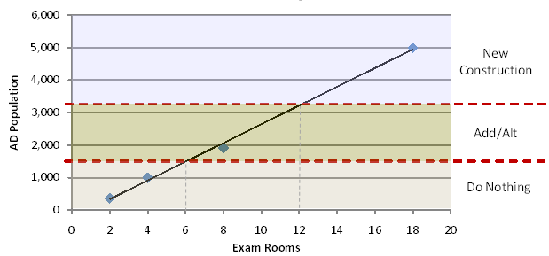
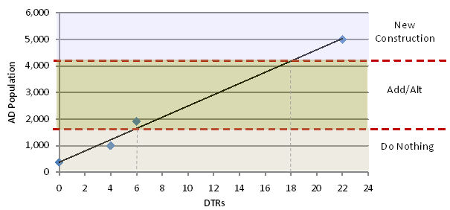
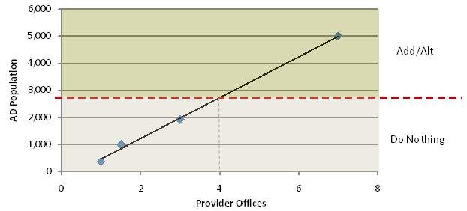
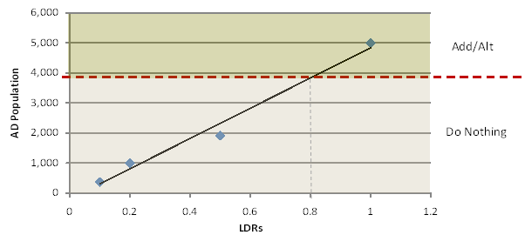
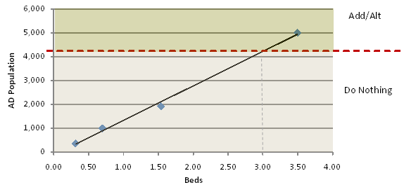
Sensitivity
Most
Sensitive
Least
Sensitive
Primary Care
Dental
Behavioral
Health
Labor & Delivery
Med/Surg

Slide 25
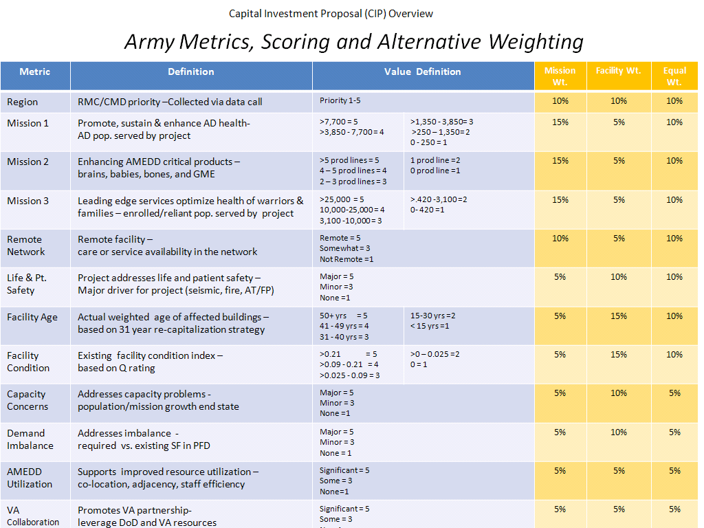
Army Scoring
Planning Data
Leadership
  Objectives
Transformation
MILCON
  Criteria
Accepted as a
decision making
system for Army
MILCON by TSG
April 2010
A
B
Union Intersection
Theory:
Project Management
Functions for Calculus
A B

Slide 26
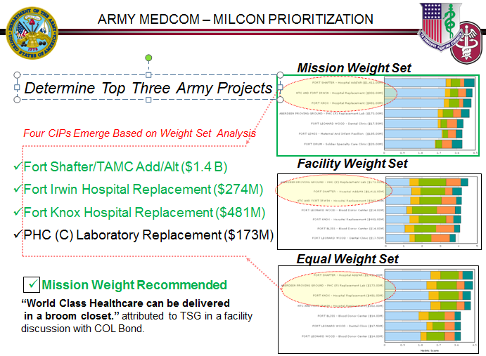
Army Medical MILCON Scoring Purpose:

Slide 27
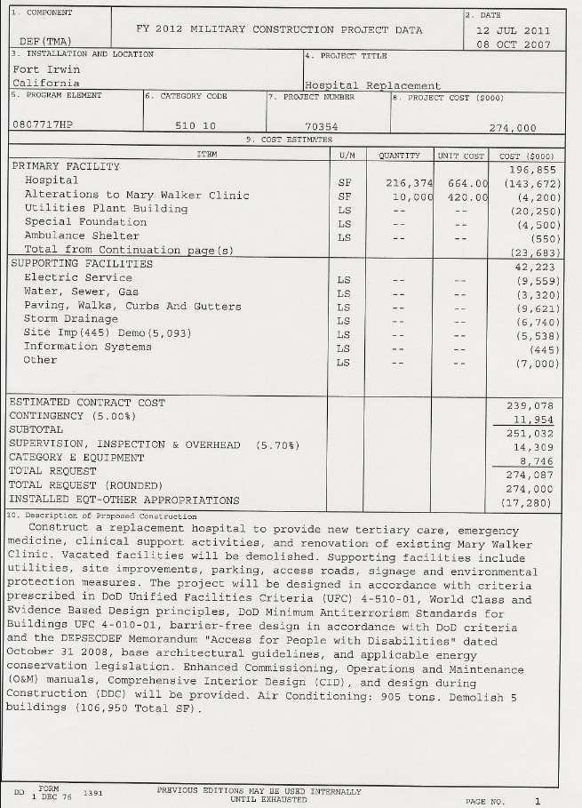
MHS Preparation
Pre-CIRB Validation Template:
3 page CIP Template: includes the required data fields directly associated with the CIDM.
Department Level Program for Design: The early design concept.
Characteristics document (# ORs, # Beds, etc.).
DD form 1391 – Project Programming Document – Front Page.
Quad Chart: A single page representation of the project. Below is the Fort Irwin CIP Quad Chart.

Slide 28
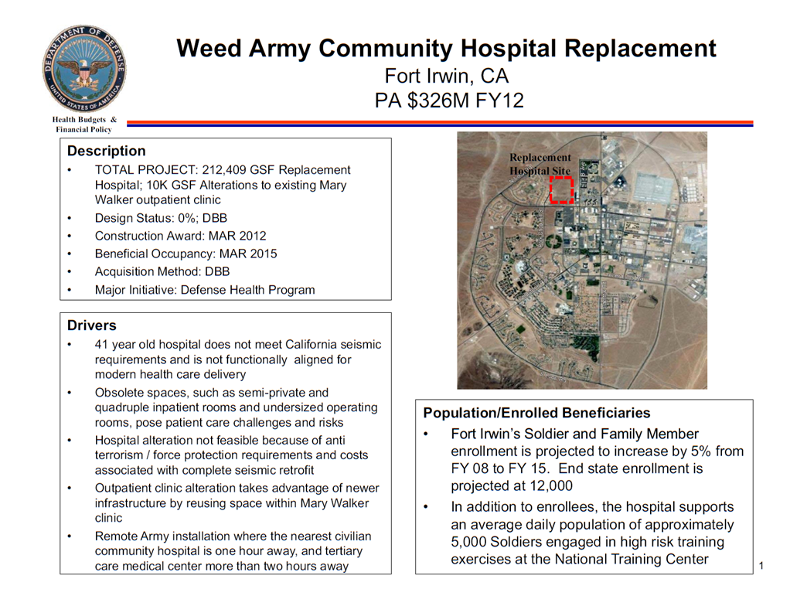

Slide 29
Demographics:
Weed Army Community Hospital on Fort Irwin provides general and limited specialty care for inpatients and outpatients. Using the Managed Care Forecasting and Analysis System (MCFAS), which produces population projections based upon zip code demographics, the following is projected through fiscal year (FY) 2013:
Active Duty: 5,227 37%
Active Duty Family Members: 6,912 49%
Retirees/ Retiree Family Members: 1,489 10%
R65+/ Medicare Eligible: 608 4%
Military Community Population: 14,235
Monthly Rotation of NTC soldiers: 5,000
Total number of medically supported personnel 19,235
Staffing Forecast:
Staffing analyses of work time rates are linked to specific medical specialties recorded from historic service levels. The following are applicable to Fort Irwin’s current level of service:
• Available clinic hours per day: 6 to 7 hours
• Available clinic days per week: 3 to 5 days
• Available procedure days per week: .5 to 2 days
• Available weeks per year: 41.2 weeks
• Average visits per hour: 1 to 3 visits
• Average provider visits per year: 1,236 to 4,326
Facility Master Plan Update Final: June 2005. Weed Army Community Hospital, Fort Irwin California, prepared by the Smithgroup and The Innova Group

Slide 30
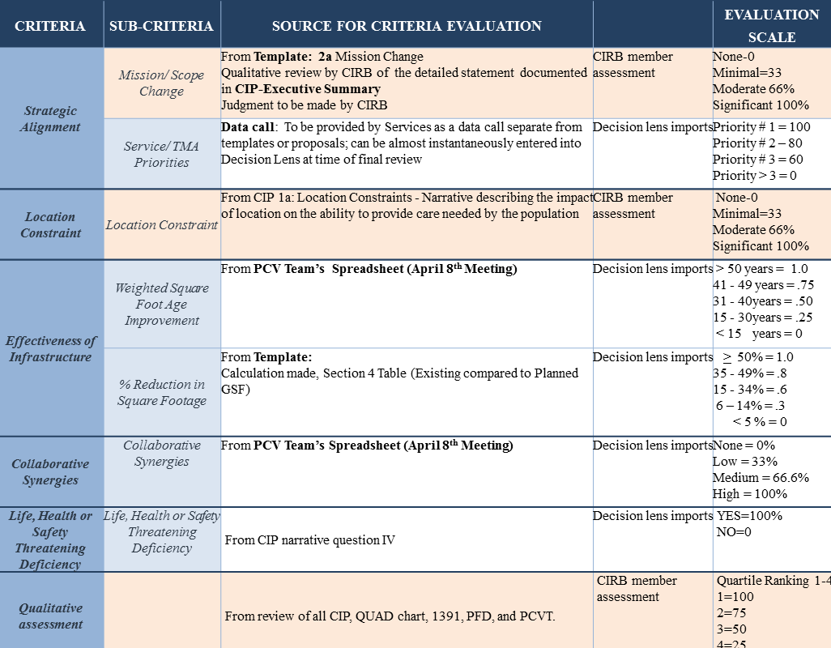
Capital Investment Decision Model:

Slide 31
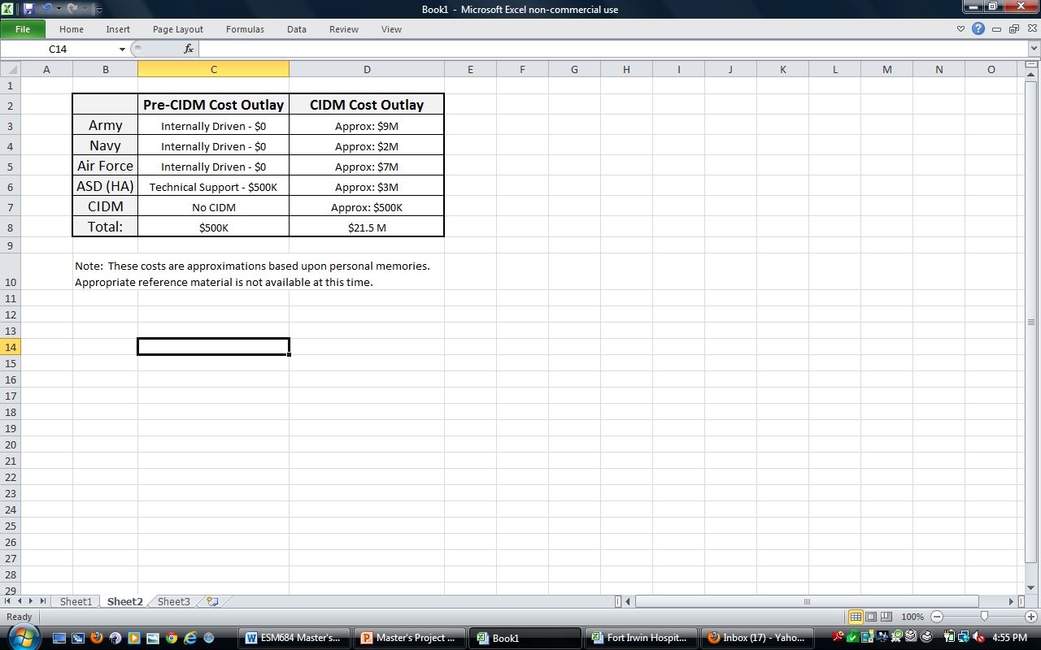
Planning Costs
Supporting CIDM
Costs Millions More
Than before 2007.
Contracted Design Firms
Travel Schedules
Meeting Locations/Facilitators
Packaging
System Development
$
2001-2007 2008-2010

Slide 32
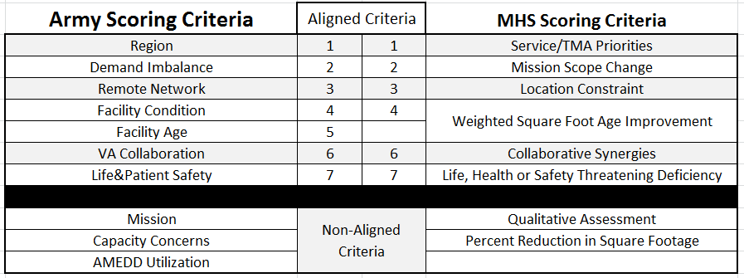
Army – MHS Score Cards
Intersections,
Greater Union
Less cost
Example:
Let say $10 per Criteria
20 Criteria, $10*20=$200
8 Criteria, $10*8= $80

Slide 33
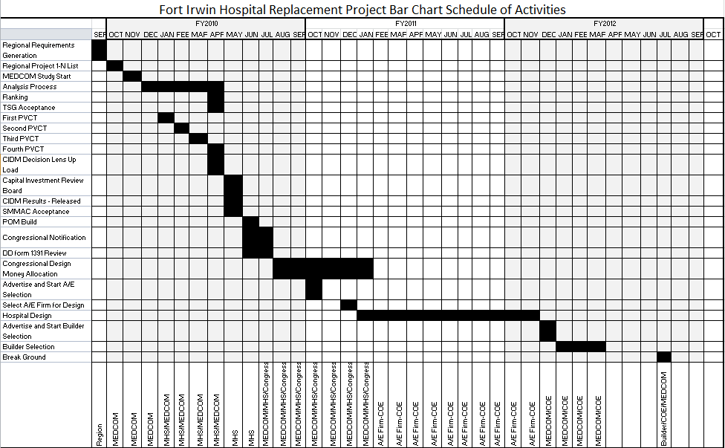
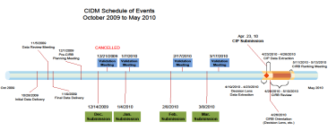
MILCON Progression Bar Chart
How to shorten
the execution period?
Cost Escalation
Earlier Funding saves
MILCON $
$300M
$300M + 300*7%
$321M
$300M + 300*7%
$343M
Project Management

Slide 34

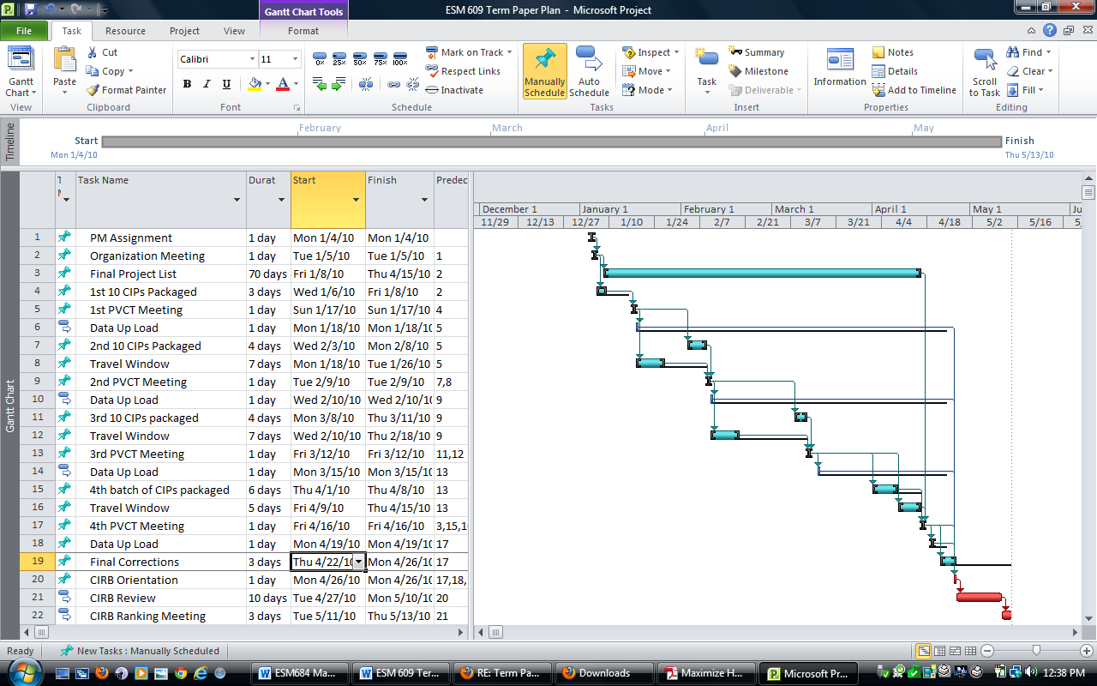
Project Schedule
Reviewed to look for time savings…
Reduce the time to build;
can’t because CP in the CIRB

Slide 35
After CIDM
DD form 1391
How to save time and money?
  $10.34M Sustainable Design & Development- Energy Policy Act - Savings?
  Evidence Based Design (EBD) - Savings?
  Acquisition Method
    Cost savings
    Time/Cost savings
  Adjusted Construction Costs
    $326M, $274M to ???

Slide 36
Sustainable Design & Development (SDD)/Energy Policy Act (EP Act).
Future Value Systematic Payments
$10.3 Million $605 Thousand
18 year investment 18 years of annual payments
5% 5.87%
$24Million $10.3 Million
USGBC began1993 and is a non-profit trade organization that promotes sustainability in
how buildings are designed, built, and operated. USGBC is best known for the development
of the Leadership in Energy and Environmental Design (LEED)
Will the new project save $605K annually or will $24M of energy be used for this facility?

Slide 37
Evidence Based Design (EBD)
$6 Million for the Fort Irwin Project
About The Center for Health Design - 2009
The Center for Health Design (CHD) is a nonprofit organization that engages and supports professionals and organizations in the healthcare, construction, and design industry to improve the quality of healthcare facilities and create new environments for healthy aging. CHD’s mission is to transform healthcare environments for a healthier, safer world through design research, education, and advocacy.
Criteria not as defined as LEED - http://www.healthdesign.org/
Would the design team not design a project with Evidence Based Design criteria?

Slide 38
Acquisition Strategy
Cost Difference
Price Escalation 7%
Cost Savings
DBB | DB
300,000,000 | 300,000,000
339000000 | 321000000
18000000 | Clinic Price
300,000,000
321000000
343470000
367512900
393238803
DBB
DB
DBB DB
13% standard design cost 6% standard design cost
2 bid selection phases 1 bid selection phase
*CMAR is not presented because no MHS cost guidance has been published;
but some saving in time compared to DBB would be expected.
TMA DD 1391 Cost Estimating Guidance For Medical Project, March 24, 2008
Notes:
CM at-risk is a delivery method which entails a commitment by the construction manager to deliver the project within a Guaranteed Maximum Price (GMP), in most cases. The construction manager acts as consultant to the owner in the development and design phases, (often referred to as "Preconstruction Services"), but as the equivalent of a general contractor during the construction phase. When a construction manager is bound to a GMP, the most fundamental character of the relationship is changed. In addition to acting in the owner's interest, the construction manager must manage and control construction costs to not exceed the GMP, which would be a financial hit to the CM company.
CM at risk is a global term referring to a business relationship of Construction contractor, Owner and Architect / Designer. Typically, a CM At Risk arrangement eliminates a "Low Bid" construction project. A GMP agreement is a typical part of the CM and Owner agreement somewhat comparable to a "Low Bid" contract, but with a number of adjustments in responsibilities required by the CM. The following are some of the potential benefits of a CM At Risk arrangement:
Budget management: Before design of a project is completed ( 6 months to 1½ years of coordination between Designer and Owner), the CM is involved with estimating the cost of constructing a project based on the goals of the Designer and Owner (design concept) and the overall scope of the project. In balancing the costs, schedule, quality and scope of the project, decisions can be made to modify the design concept instead of having to spend a considerable amount of time, effort and money re-designing and/or modifying completed construction documents.

Slide 39
MHS Determine Funding Efforts
If MHS has to be
Involved then…
Diversify Funding
Determine where MHS wants to invest…
  Hospitals (score best)
  Clinics (higher value for cost)
  Dental (higher value for cost)
  Laboratories (very rare)
  Other
Compete like projects

Slide 40
Matching Workload with Funding
One third shares work load share
Hard to quantify
Plus politics
Not a perfect metric
Population Distribution
Different Standards of Care
Different Risks – War Footing vs Peace Time
Politics/Competition
Acquisition Strategy
Delays
Centralized Decision making

Slide 41
Summary
Walter Reed started significant oversight
Little difference in funding $200M to $300M
Reduce Time to build - (prevent price escalation)
Practice Design Build - (higher risk of claims)
MHS to determine platform funding efforts
or
Match workload with funding -$21M/POM year
Recommend

Slide 42
Questions

